Slide 1
Two steps forward, one step back:
A reluctant open data science transformation in lakes research and beyond Jeff Hollister
Twitter: @jhollist

Slide 2
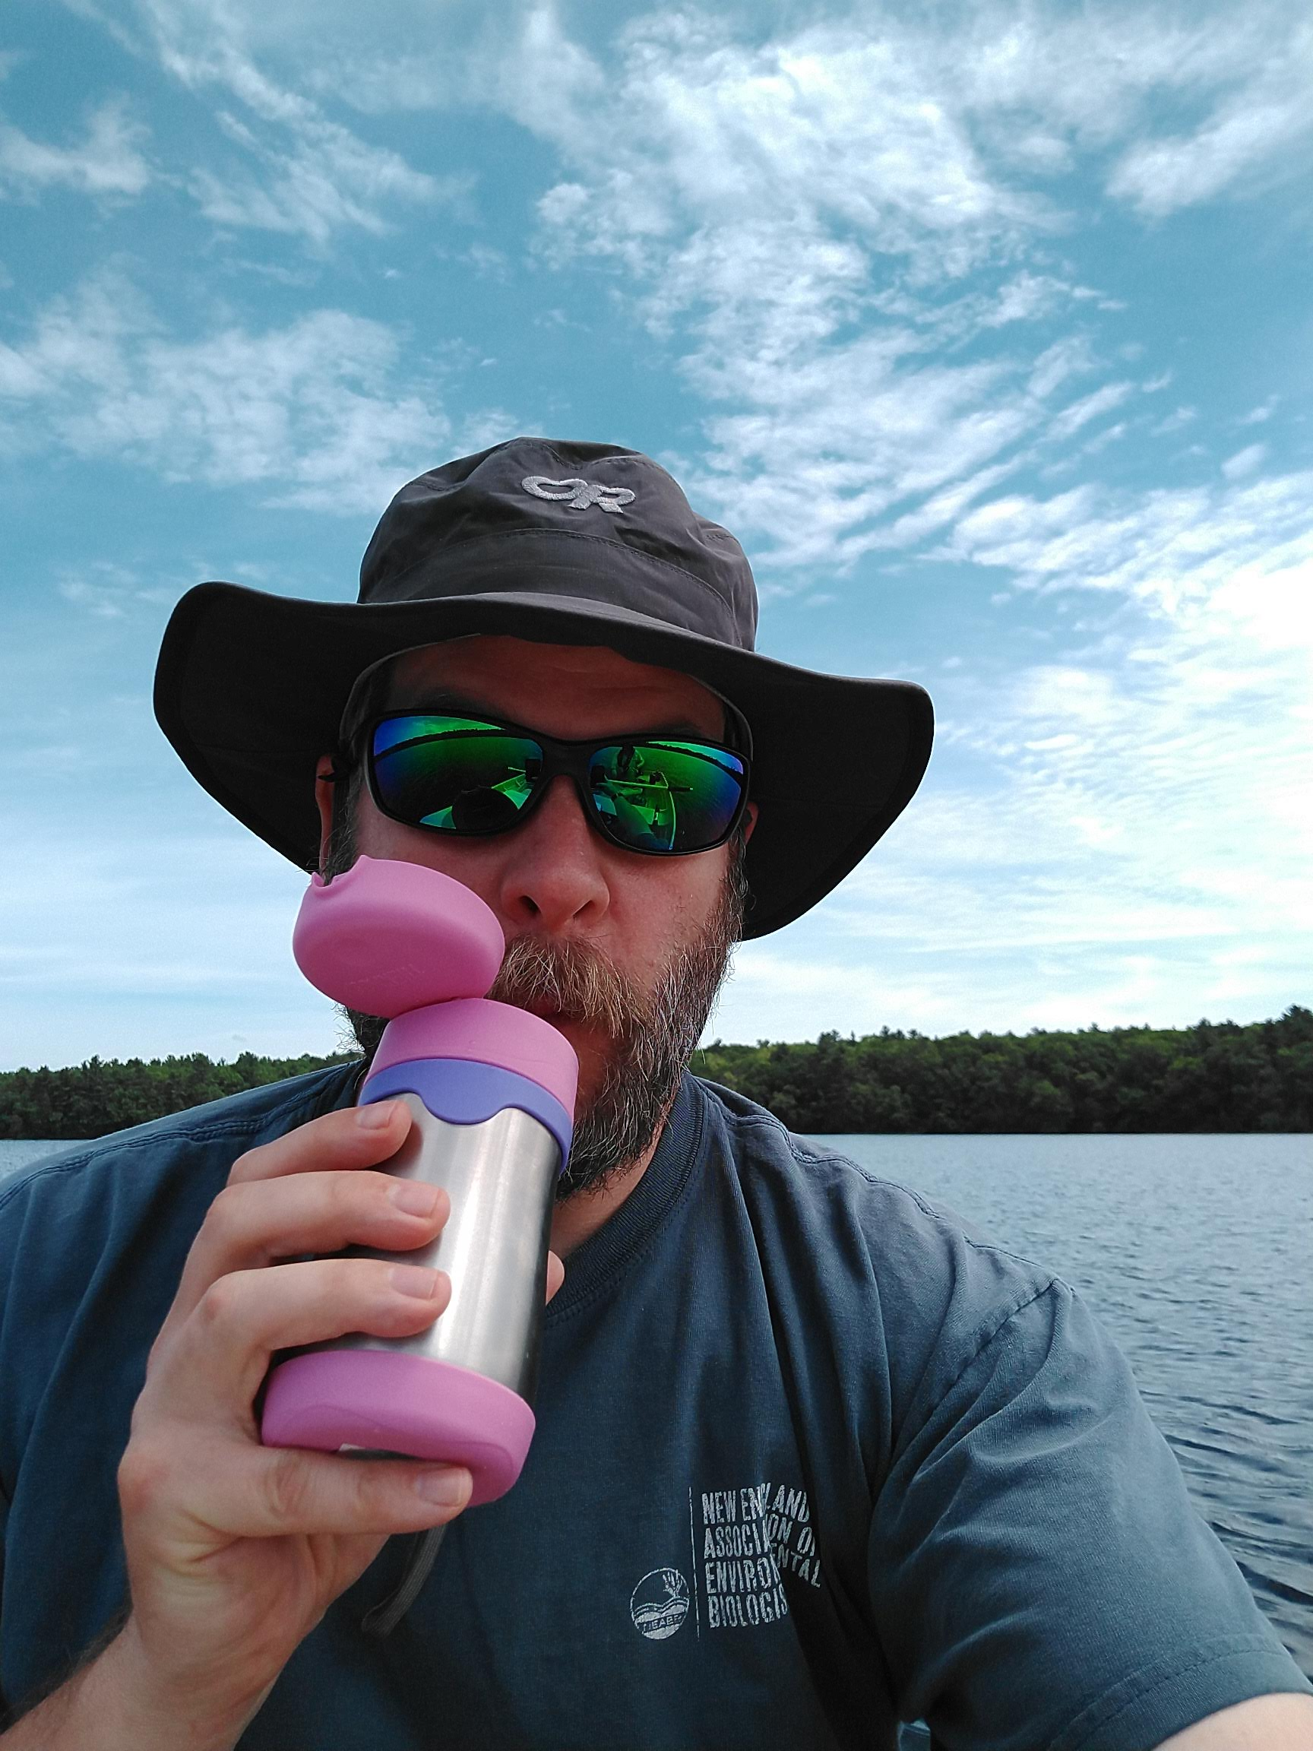
Who am I?
Landscape ecologist/GIS
Fake limnologist
Fake R guy
US EPA Research Ecologist since ~2006
Worked on: Forests, wetlands, gopher tortoise, estuaries, lakes, cyanobacteria, …

Slide 3
The rest of the cast
Lakes and computational ecology
Betty Kreakie
Bryan Milstead
Stephen Shivers
Sophie Fournier
Farnaz Nojavan (Alumnus: now a Data Scientist at FM Global)
Administrative, legal and information management
Ann Vega
Valerie Brandon
Michelle Ibarra
David Smith
Scott Albright
Geoff Cooper
Ethan McMahon
Andrew Yuen
Patrick Burke

Slide 4
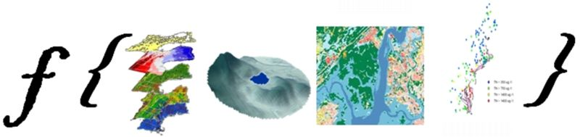
The story
Lakes and cyanobacteria
Computational approaches
Open data science tools

Slide 5

Two steps forward: R
In use for a long time
Growth in users
Office of Research and Development
Regions
Program Offices
Currently, 1102 installs

Slide 6

One step back: R
Tightly controlled and changing IT environment
Install approvals onerous and inconsistent
Often only partly-functional
Much angst

Slide 7

Progress: R
Standardized installation
Pre-approved
Requests via email
Still occasional problems…

Slide 8

Two steps forward: GitHub
GitHub for USEPA ~2013
167 repositories
623 members in the USEPA Org
177 members who have committed

Slide 9

One step back: GitHub
No collaboration for you
No Admin rights
Priced out?

Slide 10
Progress: GitHub
Can now use a collaboration platform to collaborate!
Pricing and admin issues still a work in progress
Multiple GitHub Organizations?
USEPA-ORD
USEPA-OW
etc.
Enterprise GitHub?
Bitbucket

Slide 11
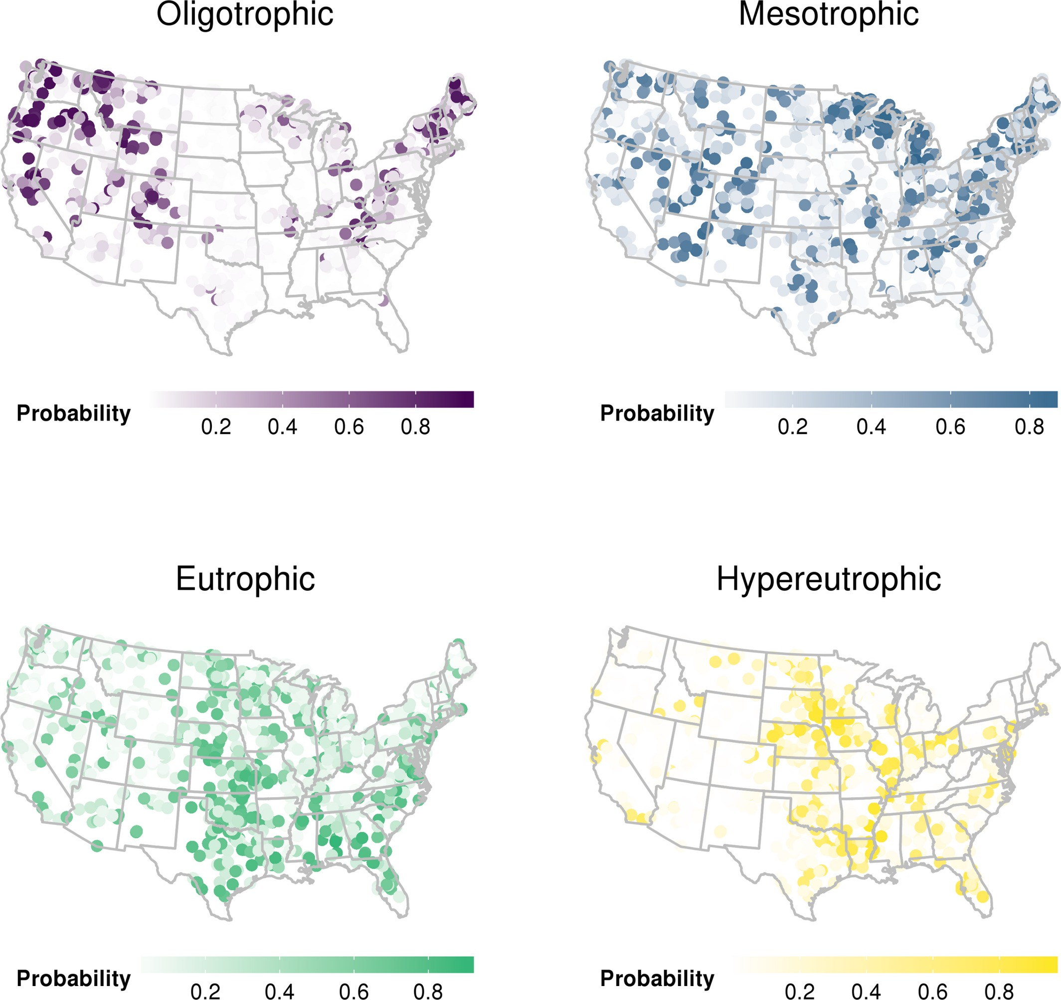
Two steps forward: Pre-prints and post-publication review
Hollister et al. (2016). Modelling lake trophic state: a random forest approach. Ecosphere
Uses NLA 2007
Random forests to predict chlorophyll a based trophic state
After clearance, before peer-review published as a PeerJ Preprint

Slide 12
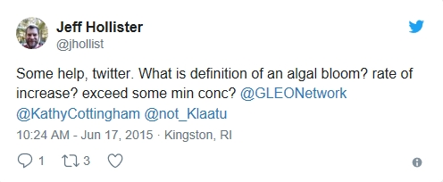
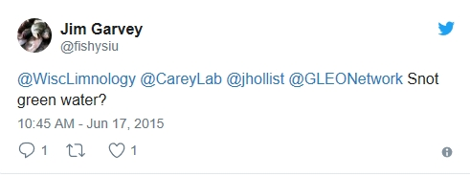
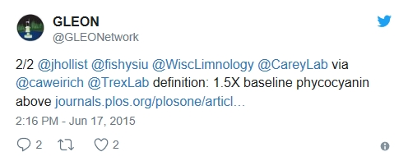
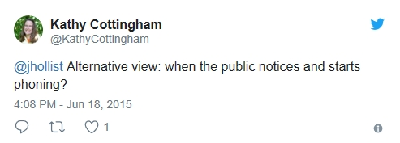
Two steps forward: Pre-prints and post-publication review
Hollister and Kreakie. (2016). Associations between Chlorophyll a and various Microcystin-LR Health Advisory Concentrations. F1000Research
Uses NLA 2007
Empirical method to answer, “What is a bloom?”
Published at F1000Research immediately after clearance

Slide 13
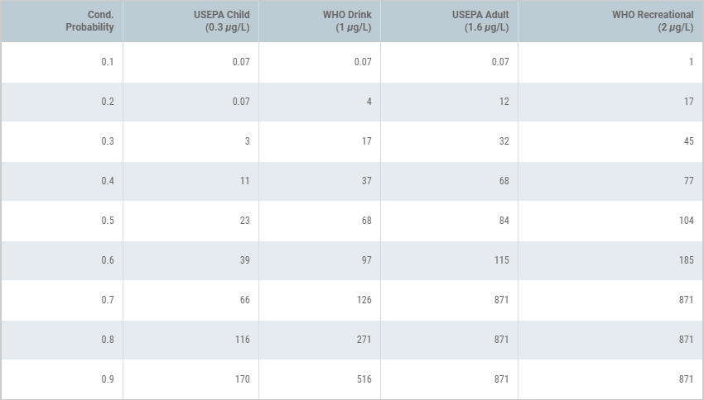
Two steps forward: Pre-prints and post-publication review
Hollister and Kreakie. (2016). Associations between Chlorophyll a and various Microcystin-LR Health Advisory Concentrations. F1000Research
Uses NLA 2007
Empirical method to answer, “What is a bloom?”
Published at F1000Research immediately after clearance

Slide 14

One step back: Pre-prints and post-publication review
Why would you do that?
Many emails
And again, much angst

Slide 15
Progress: Pre-prints and post-publication review
Briefing for lab senior managers on open science
Pre-prints and post-publication tacitly allowed
An interim policy

Slide 16
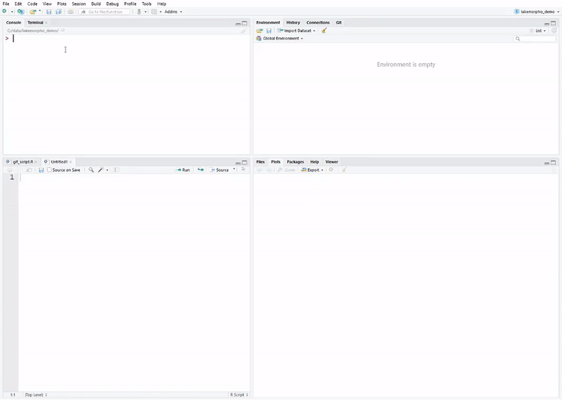
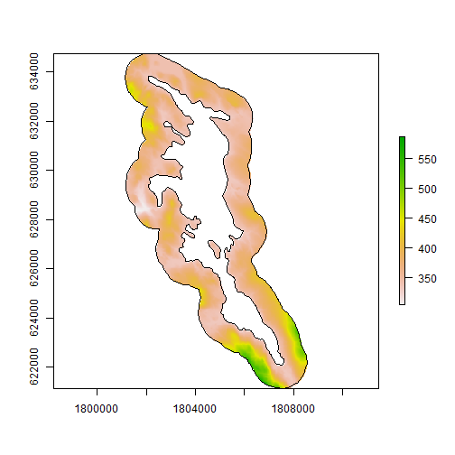
Two steps forward: Code review
lakemorpho: Lake morphometry metrics in R
sp, rgdal, rgeos, and raster
sf support to be added
National Lake Morphometry
NHD Plus
Hollister and Milstead (2010)
Hollister et. al. (2011)
Hollister and Stachelek (2017)

Slide 17
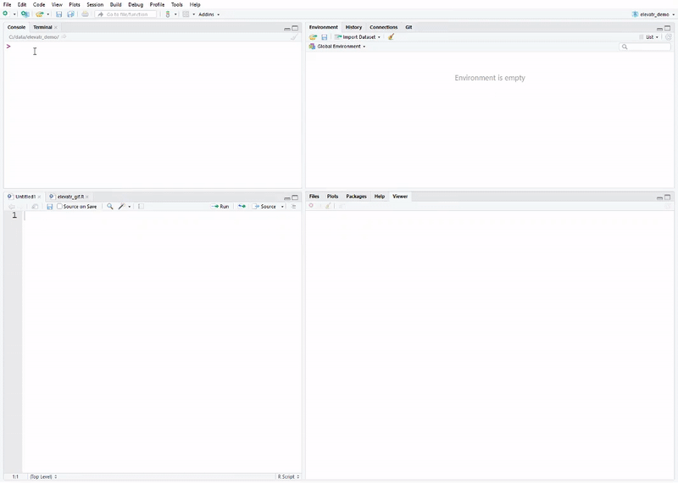
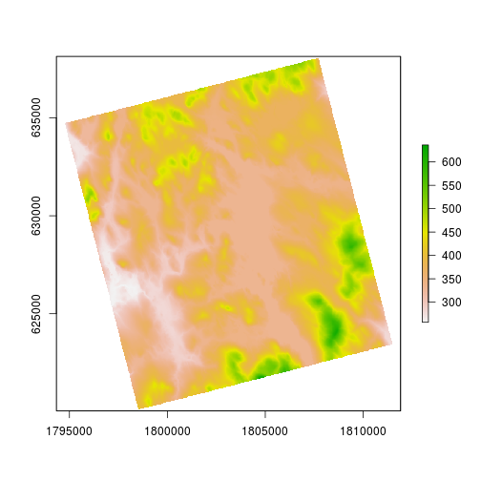
Two steps forward: Code review
elevatr: Access elevation data in R
Access elevation data in R
Mapzen
closed!
AWS
USGS
Built off of sp, rgdal, rgeos, and raster suite
sf support to be added
Development version has support for SRTM and sf objects

Slide 18
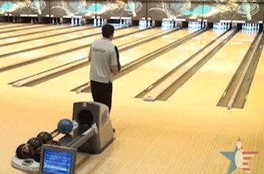
One step back: Code review
First attempt failed (see One step back: GitHub)
Lack of internal review mechanism for scientific software
But got reviewed anyway

Slide 19
Progress: Code review
New GitHub collaborator policy
Draft Scientific Software Clearance policy
With EPA Office of Research and Development Senior Managers

Slide 20

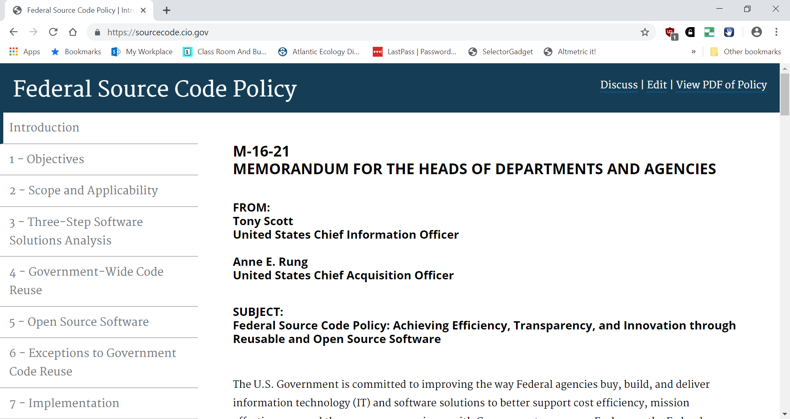
Two steps forward: Licensing
Creative Commons Zero (CC0) Approved in 2015
Federal Source Code Policy promised guidance

Slide 21

One step back: Licensing
Not quite there…
Guidance never really came
CC0 isn’t Open Source Initiative approved
e.g. prevented use of Journal of Open Source Software

Slide 22
Progress: Licensing
As of early 2019, approval for
MIT
GPL v3
LGPL-2.1
Apache 2.0.
Other licenses are under review

Slide 23

Two steps forward: Shiny
Everyone wants Shiny!
Various internal servers over the years
~20 applications on central server, many others elsewhere
EPA building skills and demand for Shiny applications
Enterprise server
cloud.gov
https://simpleepashiny.app.cloud.gov/

Slide 24

One step back: Shiny
Have gone through many “shining” doors, but never sure what is on the other side
Enterprise Shiny Server progress measured in years
Many technical hurdles with cloud.gov (i.e. don’t be first)

Slide 25
Progress: Shiny
Tantalizingly close to first apps on shiny.epa.gov
Making progress on other fronts for Shiny
e.g. EPA AWS Platform

Slide 26
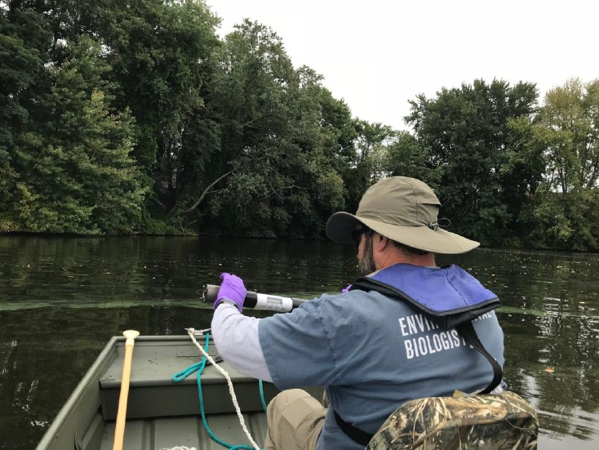
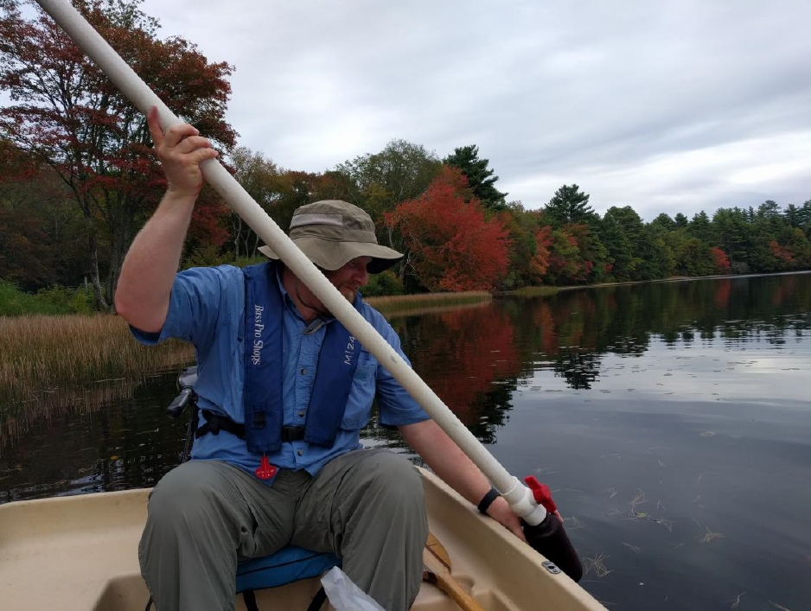
Two Steps Forward: Bringing it all together
Current project: Temporal and spatial dynamics of cyanobacteria in Rhode Island ponds
Twice weekly sampling, three ponds in RI, 7 stations per pond
Chlorophyll, phycocyanin, nutrients, physical profiles, zoo- and phytoplankton
Uses much of the open data science toolset

Slide 27
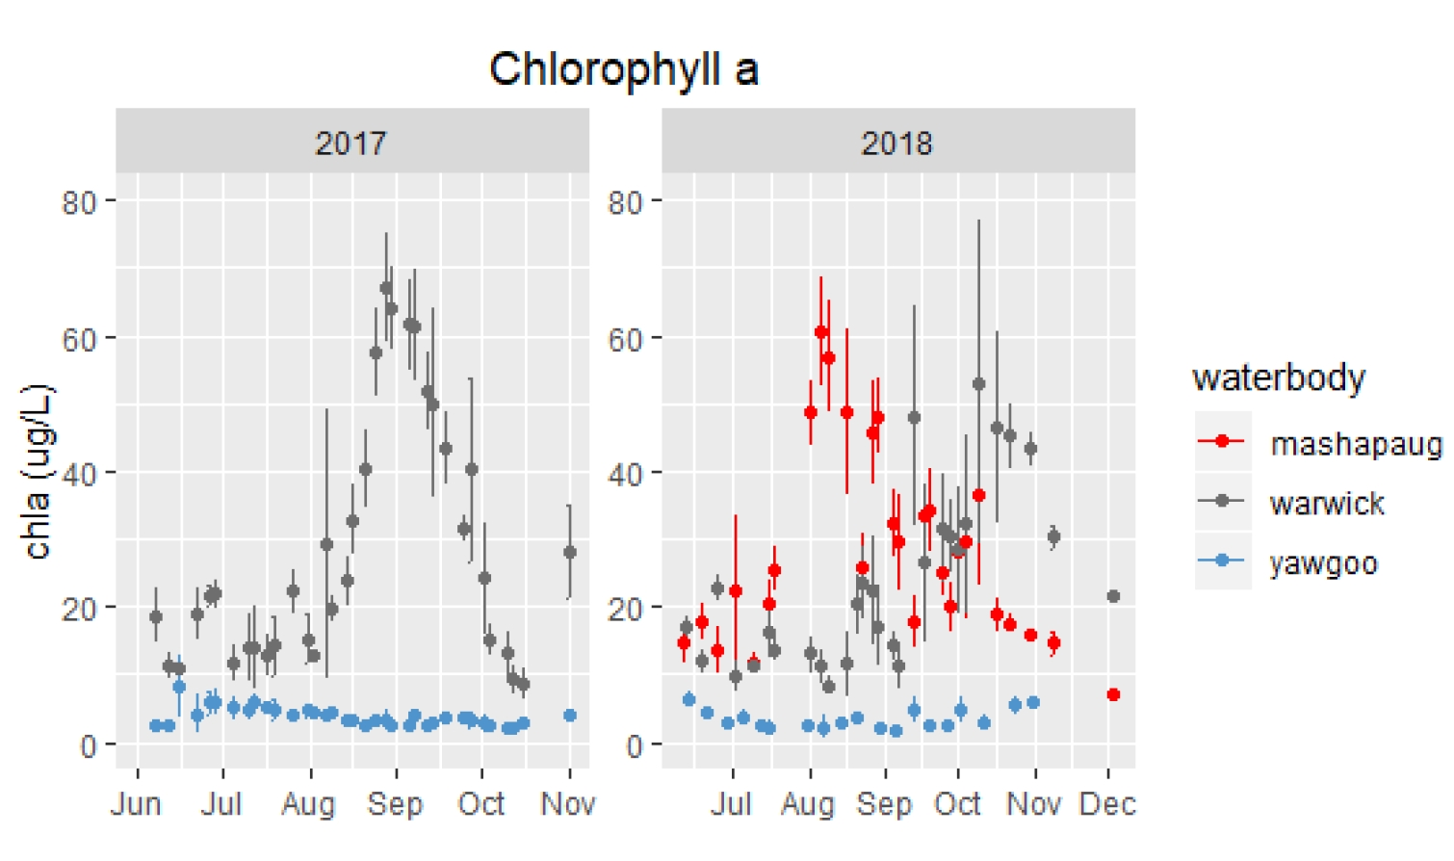
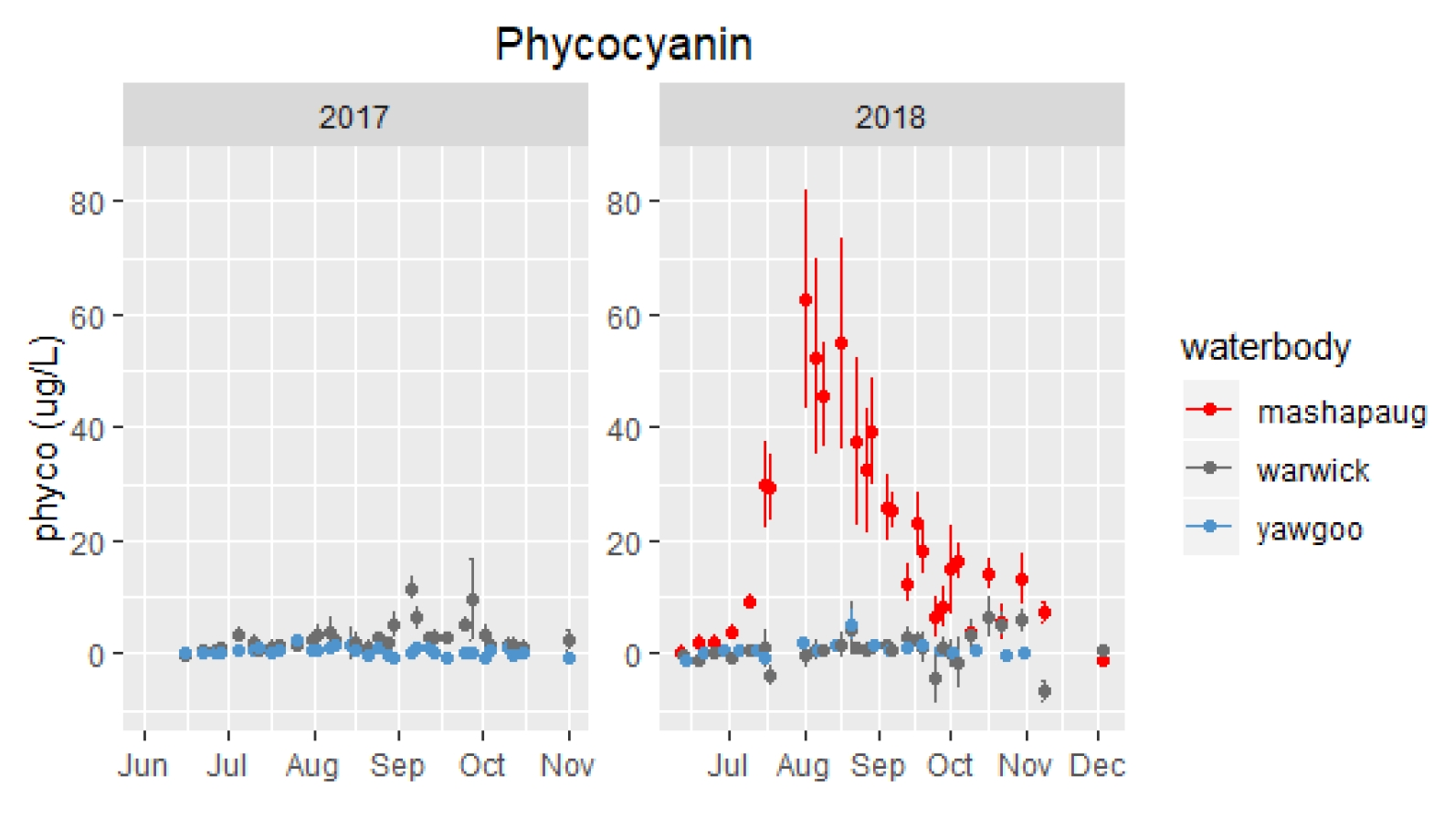
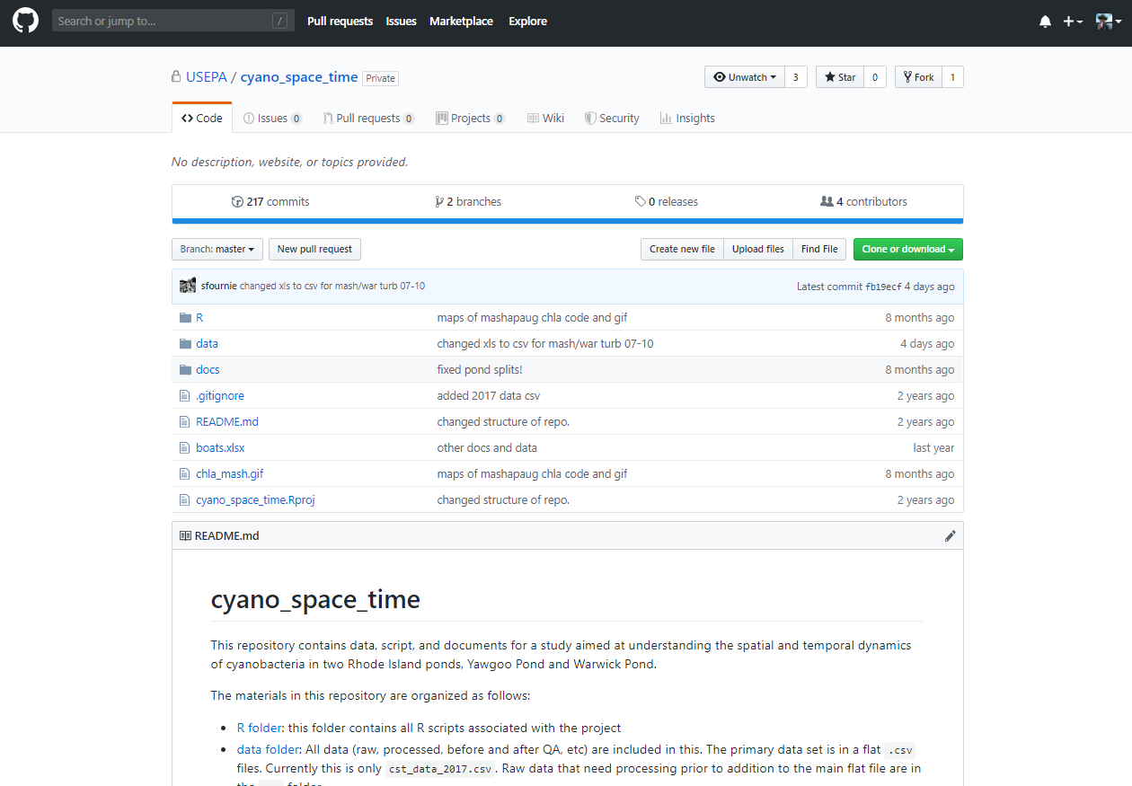
Two Steps Forward: Bringing it all together

Slide 28

One Step Back: Bringing it all together
So far, so good!

Slide 29
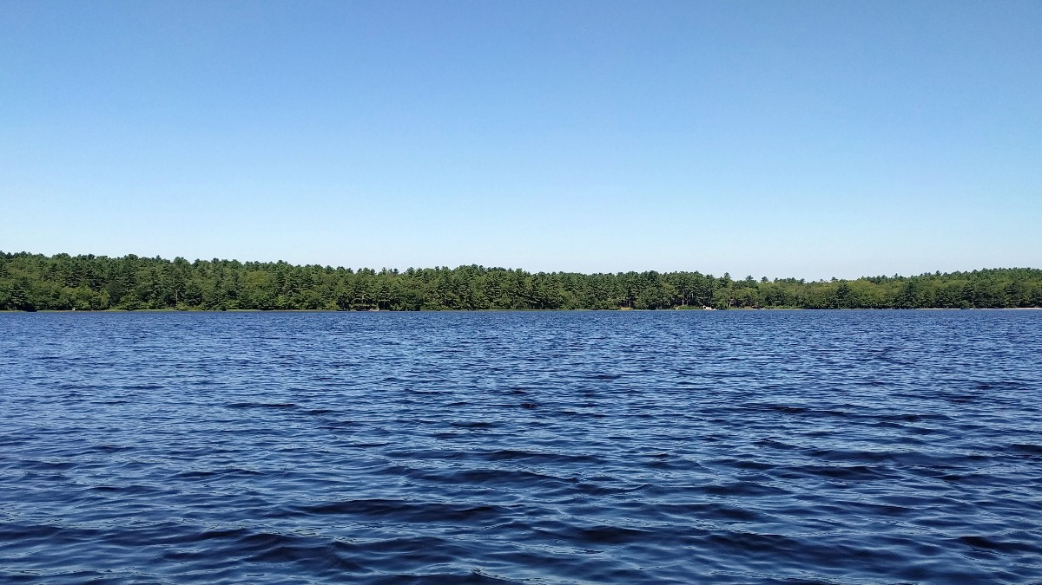
Unorganized parting thoughts
Future challenges
FLAMe and DIY buoys
Data collection from buoys anticipated as an issue
This is a documentary, not a how-to
Much of this progress required occasional subversion

